Slide 1
Blogger
Another blogging system in PHP yet.
https://github.com/demonmind/blogger - source

Slide 2
Features
Login Page
User Registration
All Blog List
Personal Blog
Comments on Blog Posts
Delete Blog/Comment/Post
SuperUser account
…and much more
Restrictions
Users can not view pages of the blogging system unless they are authenticated .
User can Post/Delete to his own blog but can only view other Blogs.
SuperUser can execute any function on any blog
Only 1 blog Per User

Slide 3
Application Overview
Core of the application 2 pages
Blog.php
Functions.php
…the rest of the pages are support pages used to make the application work.
Use of Sessions to keep track of users.

Slide 4
Source Code(snippets)
function createBlog($owner_id, $slug){
$conn = mysql_connect(HOST, USER, PASS)or die("Mysql connection error:". mysql_error());
$db = mysql_select_db(DB_NAME);
$create = "INSERT INTO blogs(blogID, user_id, slug) VALUES(DEFAULT, '{$owner_id}', '{$slug}')";
$result = mysql_query($create);
if(!$result){
die("Invalid query ".mysql_error());
}
mysql_close($conn);
return $slug;
}

Slide 5
Source Code(snippets)
function createPost($owner_id, $blog_id, $title, $message){
$conn = mysql_connect(HOST, USER, PASS)or die("Mysql connection error:". mysql_error());
$db = mysql_select_db(DB_NAME);
$create = "INSERT INTO posts(postID, blog_id, user_id, title, message, date ) VALUES(DEFAULT, '{$blog_id}', '{$owner_id}', '{$title}', '{$message}', CURRENT_TIMESTAMP)";
$result = mysql_query($create);
if(!$result){
die("Invalid query ".mysql_error());
}
mysql_close($conn);
return $title;
}

Slide 6
Blog.php(snippet)
<?php
session_start();
require('config/database.php');
require('config/functions.php');
$username = $_SESSION['username'];
$login = $_SESSION['login'];
setUserSession($username);
//Check do we have username and password
?>

Slide 7
Blog.php(snippet)
if(verifyPostPerms($slug) == 'ok' || isSuperadmin($_SESSION['user_id'])){
echo("<div class='createpost'><a href='post.php?bid=".$bid."&bname=".$bname."'>Post to Blog</a></div>");
if(verifyPostPerms($slug) == 'ok' || isSuperadmin($_SESSION['user_id']) || getCommentAuthor($comm['commentID']) == $username){
echo("<div class='deletePost'><a href='#' onclick=\"confirmationComm(".$comm['commentID'].",'".$slug."');\">Delete Comment</a></div>");
}

Slide 8
Functions Snippet
function verifyPostPerms($blog){
$conn = mysql_connect(HOST, USER, PASS)or die("Mysql connection error:". mysql_error());
$db = mysql_select_db(DB_NAME);
$case = '';
$sql = "SELECT user_id FROM blogs where slug = '{$blog}'";
$result = mysql_query($sql);
if(!$result){
die("Invalid query ".mysql_error());
}else{
while($row = mysql_fetch_array($result)){
if($_SESSION["user_id"] == $row['user_id']){
$case = 'ok';
}else{
$case = 'deny';
}
}
}
return $case;
mysql_close($conn);
}

Slide 9
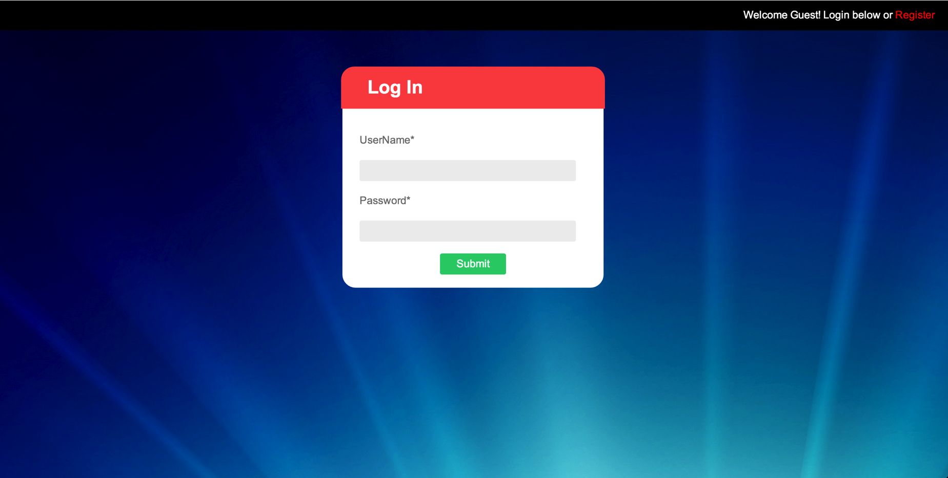
Home Page

Slide 10
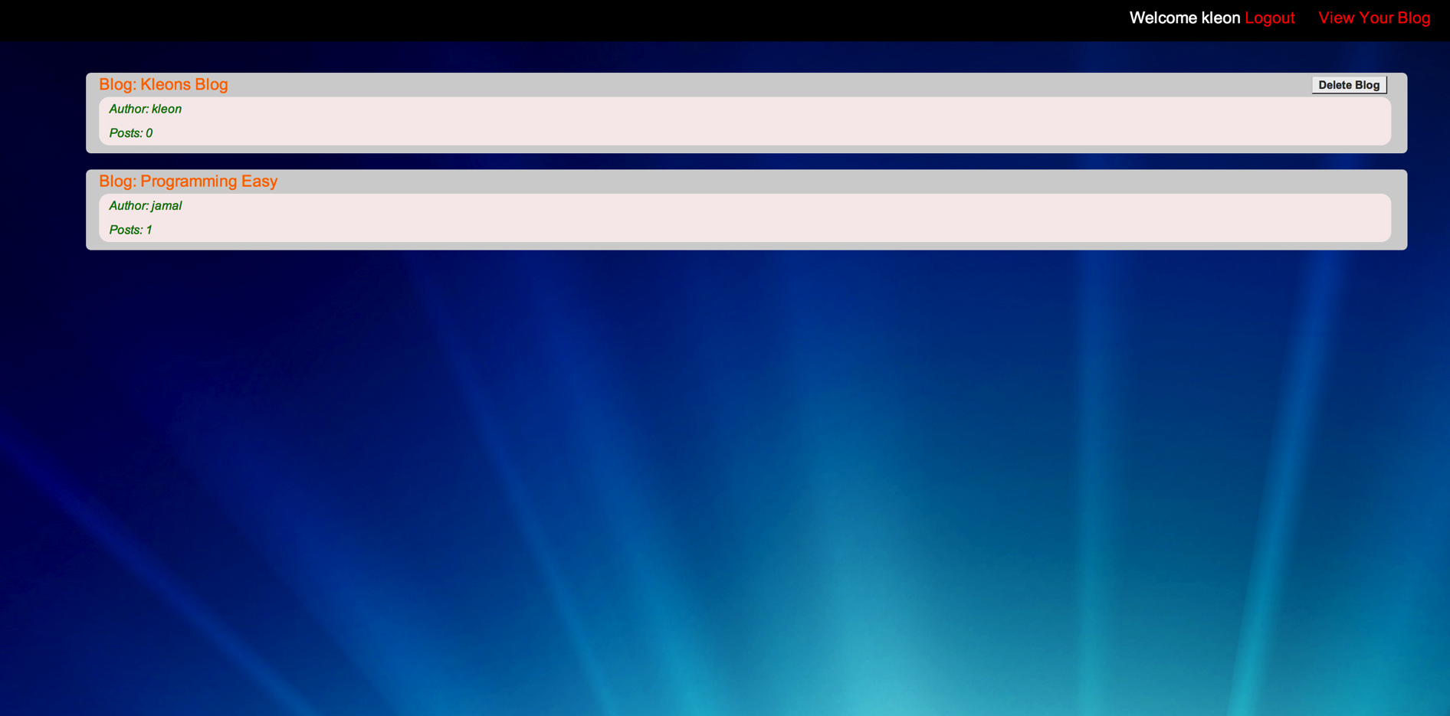
Blogs Page

Slide 11
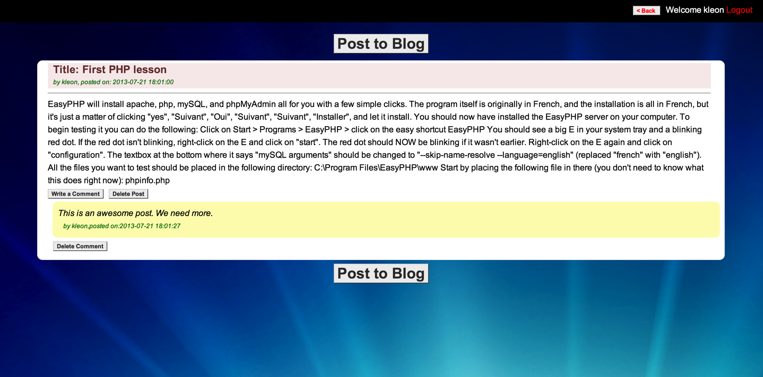
Specific Blog View

